Slide 1
Welcome to Intelligent Energy
Author
Date
External Public – Copyright © Intelligent Energy Limited 2024. All Rights Reserved
Powering the hydrogen future® with our outstanding fuel cells and service.

Slide 2
23 years’ experience
Over 200 employees
Over 600 patents
12 modular products
Powering the hydrogen future®
Hydrogen fuel cell manufacturer
Products from 800W to 300kW
Automotive, aerospace, telecoms, marine, rail, materials handling, stationary and portable power
Based in the UK
US, Japan, South Korea and China.
Credited with ISO 9001:2015, ISO 14001:2015, ISO 45001:2018
External Public – Copyright © Intelligent Energy Limited 2024. All Rights Reserved

Slide 3
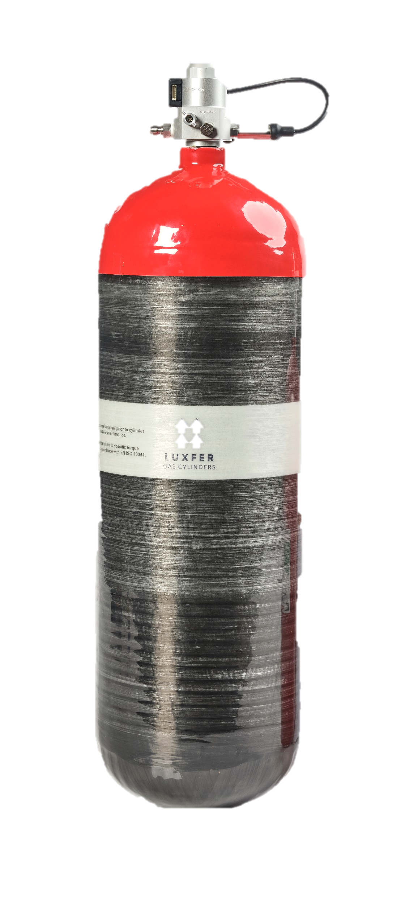
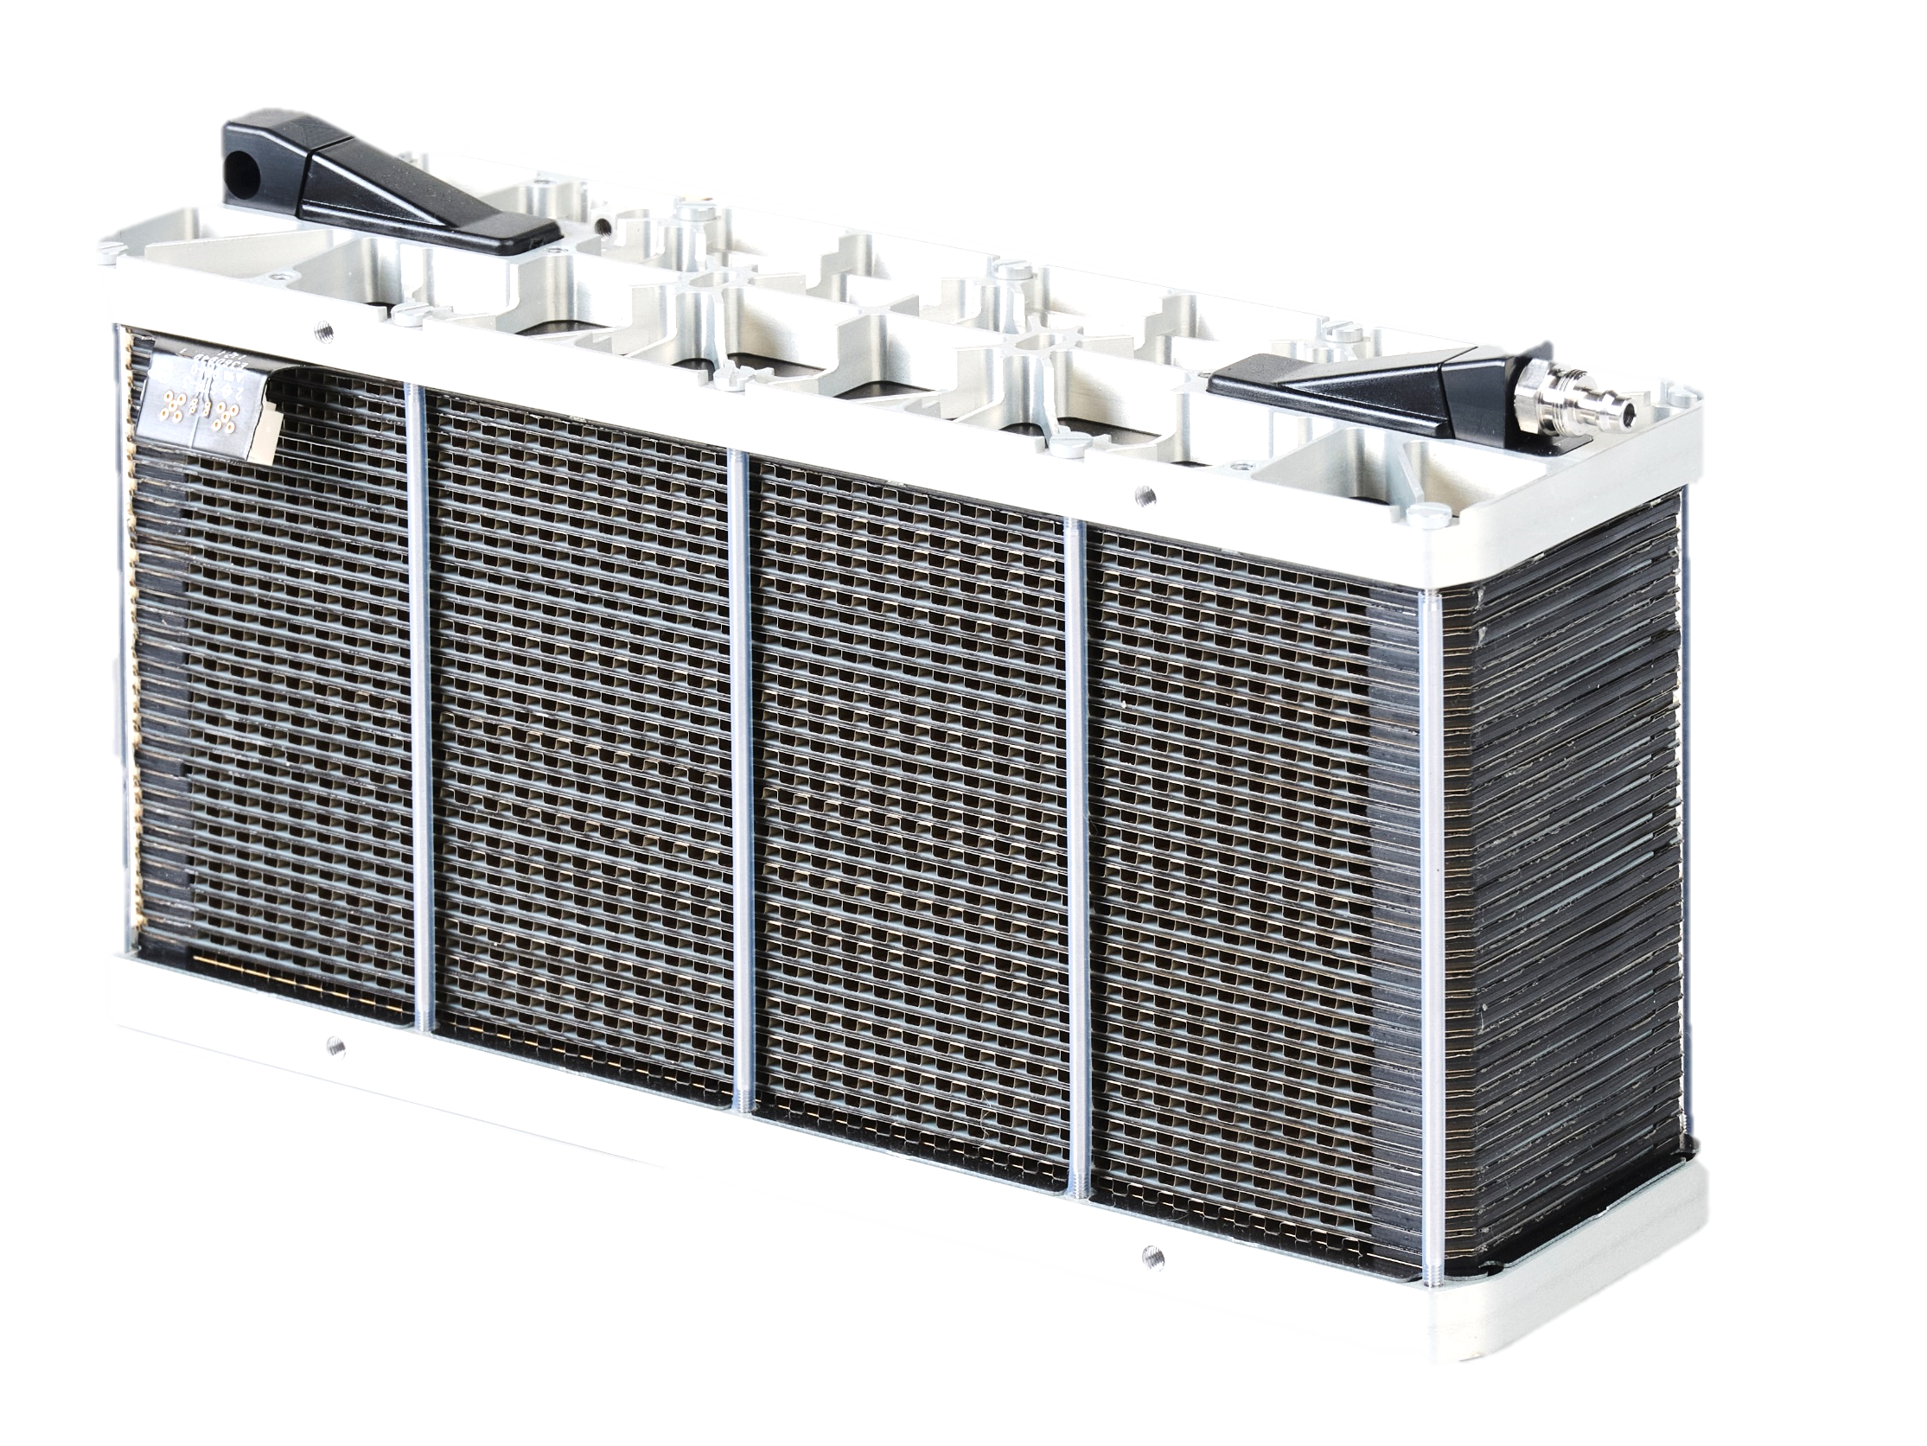
What is a fuel cell?
Fuel cells generate electricity through an environmentally friendly electrochemical reaction.
A zero-emissions solution.
Produces continuous power when hydrogen and air are supplied.
No combustion is involved.
=
Fuel cell stack
Hydrogen
Air
Electricity
Pure water

Slide 4
Zero-emission power from 800W to 1MW
Notes:
Add power rating to each of the product slides

Slide 5
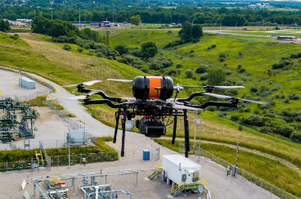
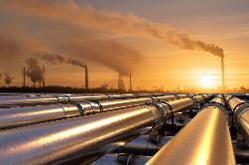
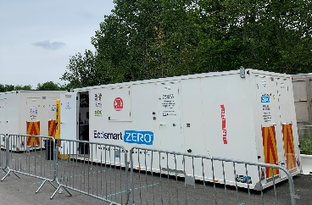
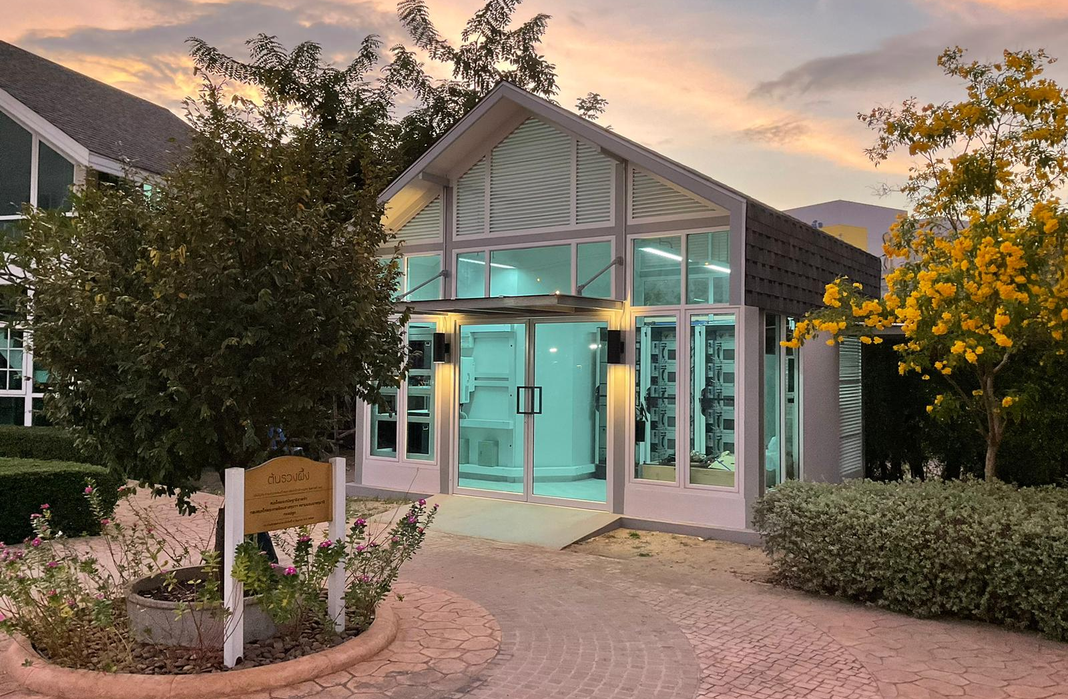
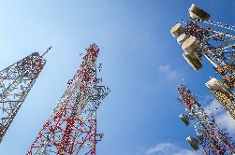
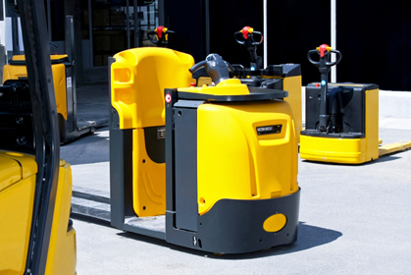
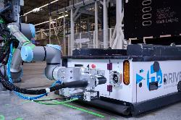
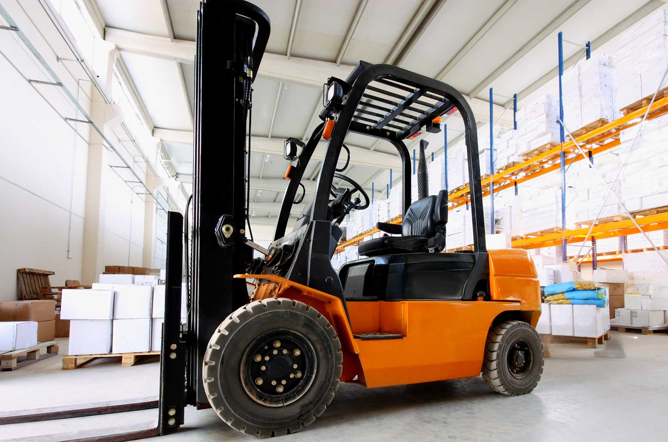
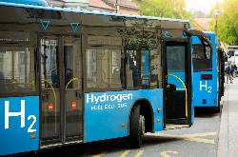
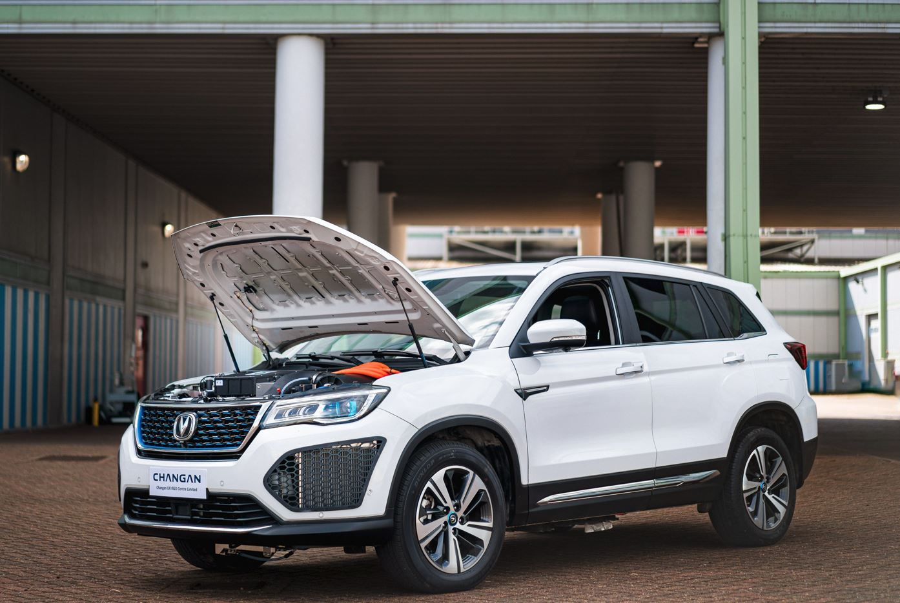
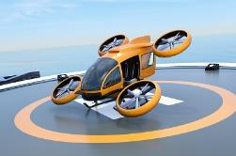
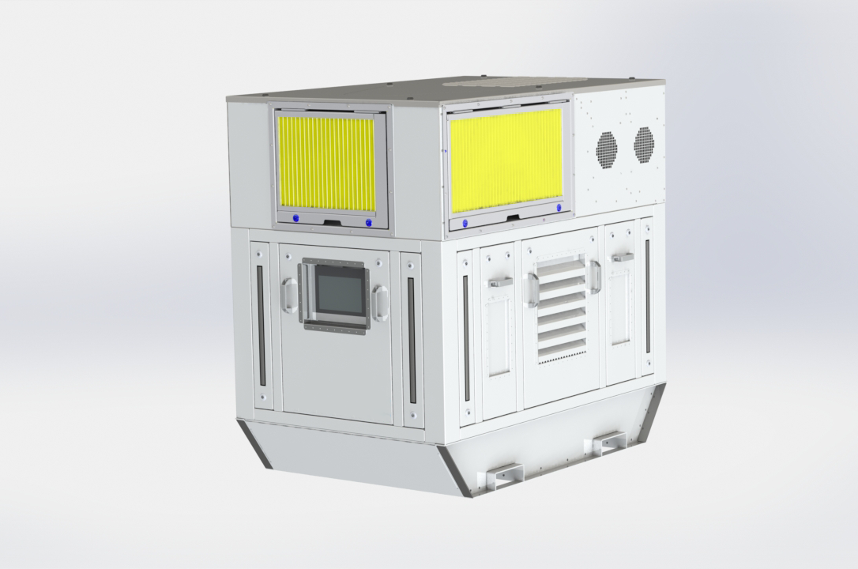
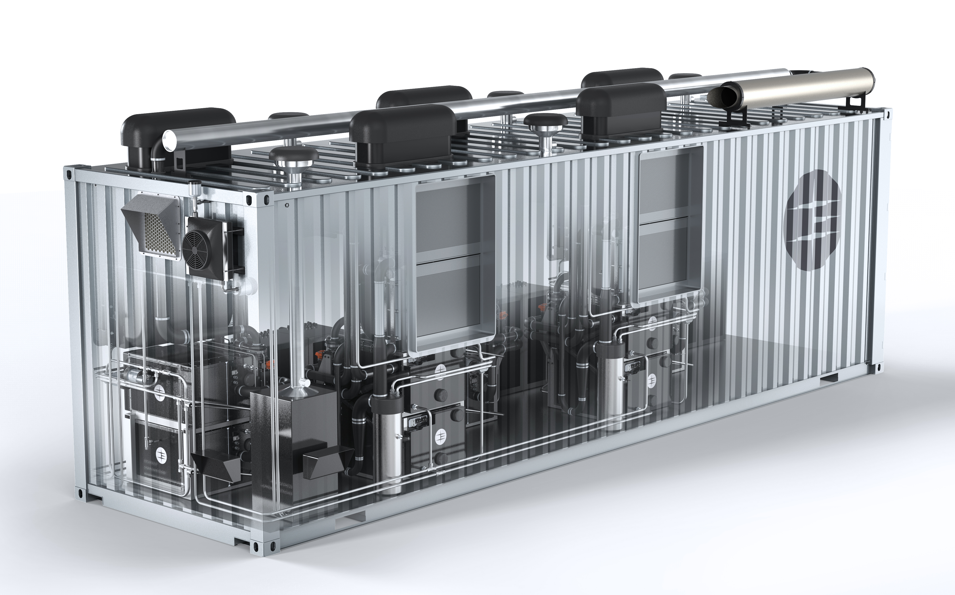
800W – 24kW
Surveying
Mapping
Pipeline
Inspection
1kW – 32kW
Construction
Stationary
Power
Telecoms
1kW – 60kW
Warehouse
Trucks
AGVs
Counter
balance
100kW – 300kW
Buses and
Trucks
Cars
Stationary
Power
100kW – 300kW
eVTOL
Small
Aircraft
Large
Aircraft
200kW – 1MW
Stationary
Power
Mobile
Power
Marine
Notes:
Add white space back into the page

Slide 6
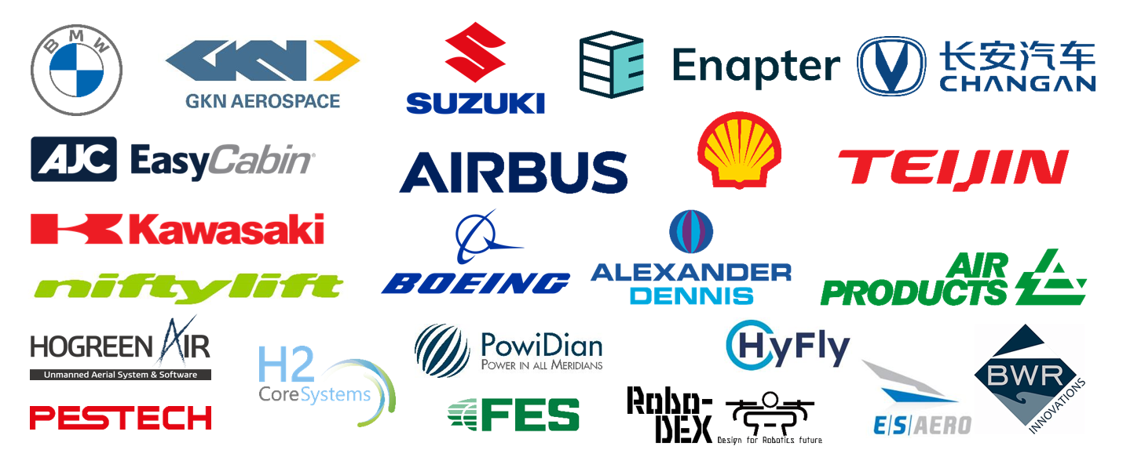
Our partners and customers
Notes:
*Nifty lift?
*Kawasaki?
*re-add Suzuki?

Slide 7
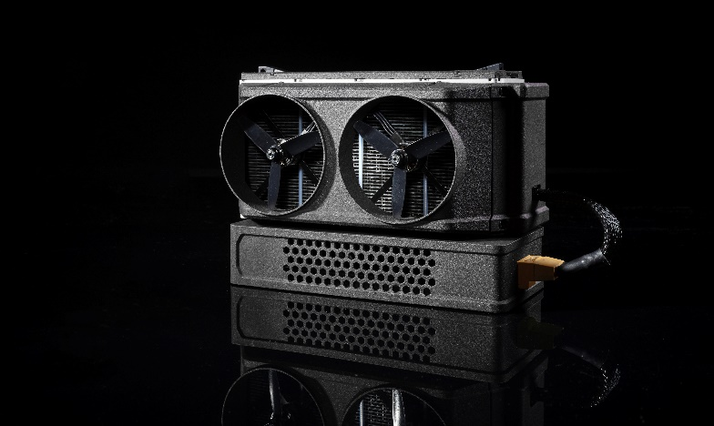
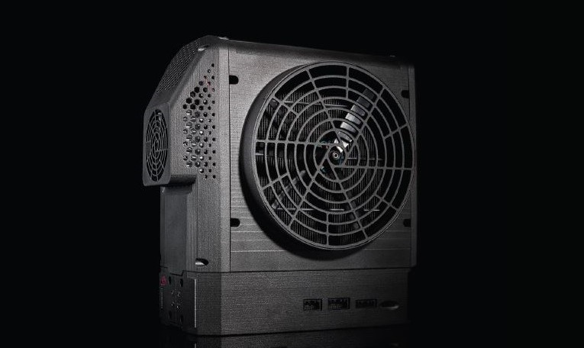
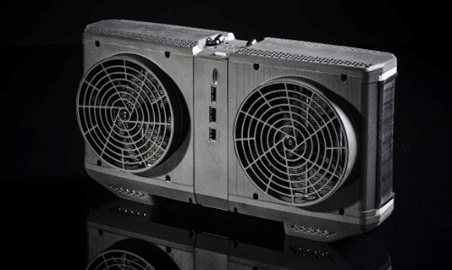
IE-SOAR:
800W – 24kW for drone and VTOL applications
IE-SOAR 800
3 to 5 times the flight time over batteries
2-3 minute refuelling
Combine systems in parallel for 800W to 24kW systems
Over 1000 hours life
Rotary wing, fixed wing and VTOL applications
Unlock BVLOS operations
IE-SOAR 1.2
IE-SOAR 2.4
Powering the hydrogen future® with our outstanding fuel cells and service.

Slide 8
Case studies
Replace your battery and unlock long endurance flight
Pipeline inspection with Shell
Broadcasting the Sail Grand Prix
Military Surveillance
External Public – Copyright © Intelligent Energy Limited 2024. All Rights Reserved
Powering the hydrogen future® with our outstanding fuel cells and service.

Slide 9
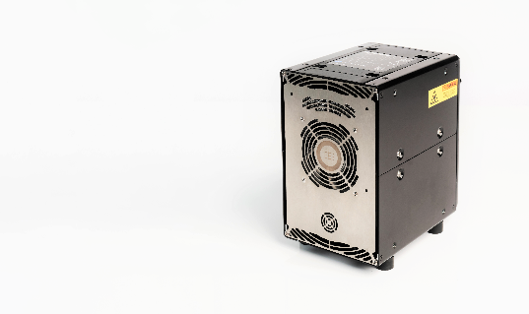
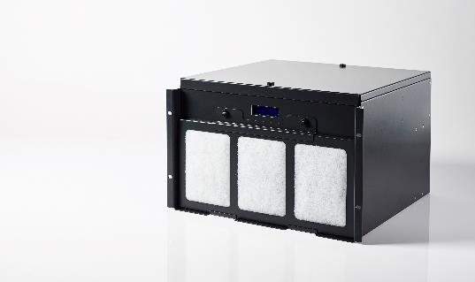
IE-POWER:
1kW – 32kW for standby power, telecoms and construction
Small, light, power dense hydrogen fuel cells
Modular, scalable and easy to integrate
Unique patented airflow management
Quiet operation
Wide environmental envelope
Robust against high shock and vibration incidence
IE-POWER 1
IE-POWER 4
Powering the hydrogen future® with our outstanding fuel cells and service.

Slide 10
Case studies
Zero emission hydrogen fuel cell solutions to meet your net zero targets
Fuel cell electrolyser demonstrator site for EGAT in Thailand
Stationary power for welfare cabins on HS2 sites
Back up power systems for telecoms sites with Netis
Power in off-grid locations with Powidian
External Public – Copyright © Intelligent Energy Limited 2024. All Rights Reserved
Powering the hydrogen future® with our outstanding fuel cells and service.
Notes:
Add end users

Slide 11
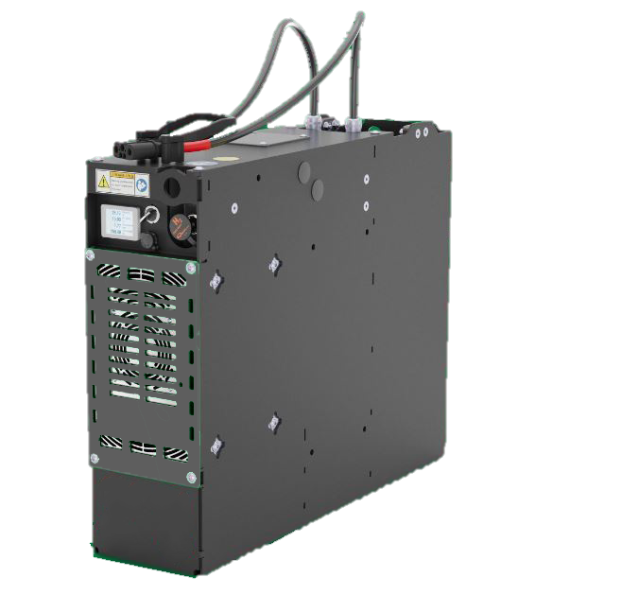
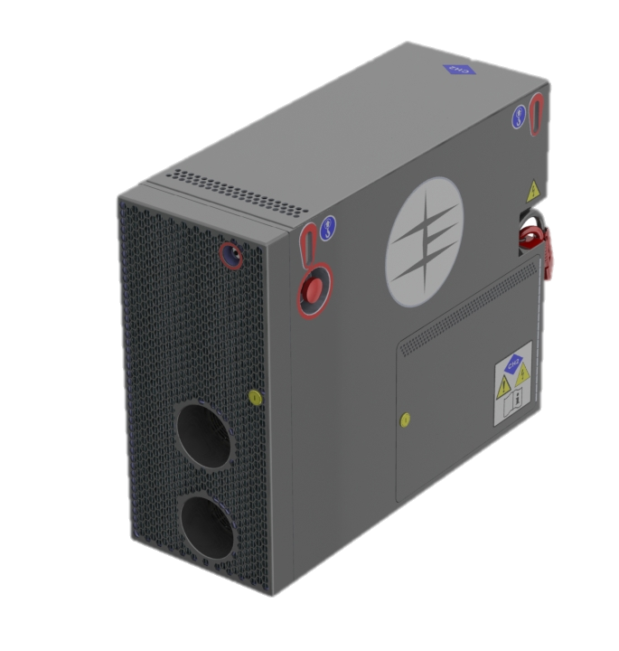
\\\\\\
IE-LIFT:
1kW – 60kW for material handling equipment
Complete battery replacement – 24V / 36V / 48V
Simple retrofit using existing FLT connections
Rapid refuelling improves fleet availability
Easily scalable with site / fleet expansion
Improved TCO for intensive operations
IE-LIFT 1
IE-LIFT 2 & 4
Powering the hydrogen future® with our outstanding fuel cells and service.

Slide 12
Case studies
Rapid refuelling, improved availability, lower TCO
Fuel cell powered Automated Guided Vehicles at BMW Plant
World's first hydrogen-electric powered access platforms with Niftylift
External Public – Copyright © Intelligent Energy Limited 2024. All Rights Reserved
Powering the hydrogen future® with our outstanding fuel cells and service.
Notes:
Add end users

Slide 13
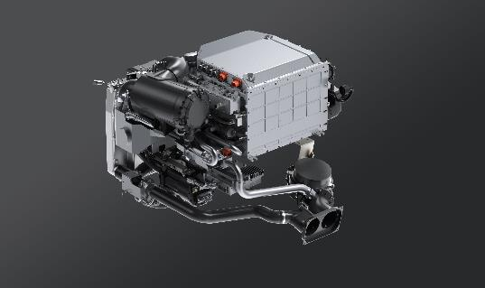
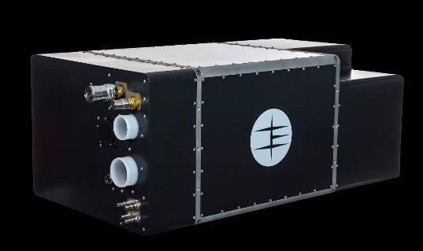
IE-DRIVE:
100kW – 300kW for automotive applications
High power density
Compact and easy to integrate
Patented cooling technology
Scalable and modular
Long life span
Range and re-fuelling experience similar to ICE
IE-DRIVE 100
IE-DRIVE HD100
Powering the hydrogen future® with our outstanding fuel cells and service.

Slide 14
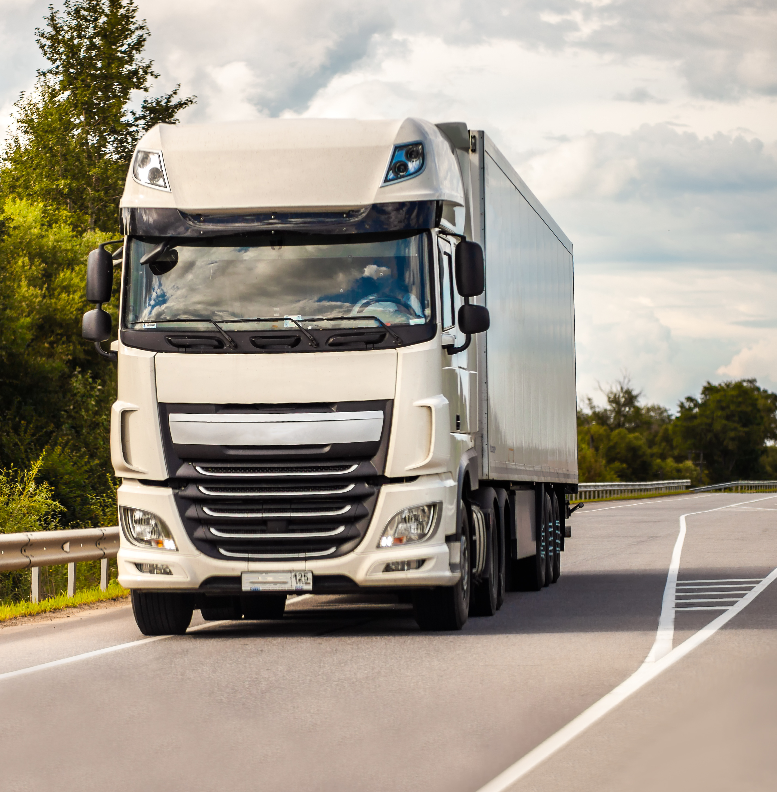
Case studies
High power, lightweight, modular fuel cells for automotive and stationary use
Fuel cell powered passenger vehicles with Changan UK
44 tonne HGV developed with MIRA and Viritech
Fuel cell powered buses with TYCE, Taiwan
600kW microgrid at Hickam Air Force Base in Honolulu, Hawaii
External Public – Copyright © Intelligent Energy Limited 2024. All Rights Reserved
Powering the hydrogen future® with our outstanding fuel cells and service.

Slide 15
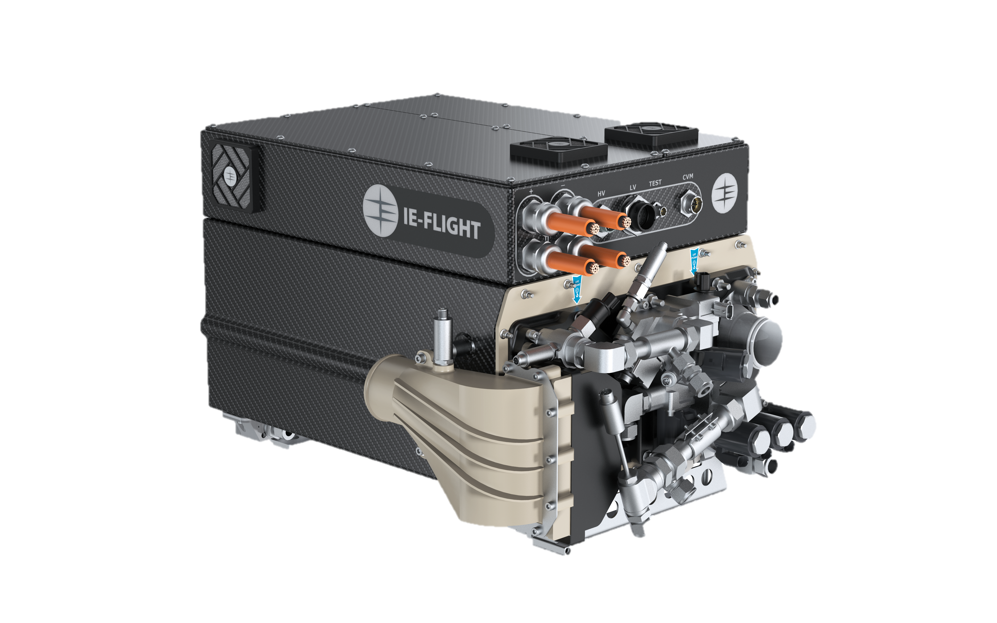
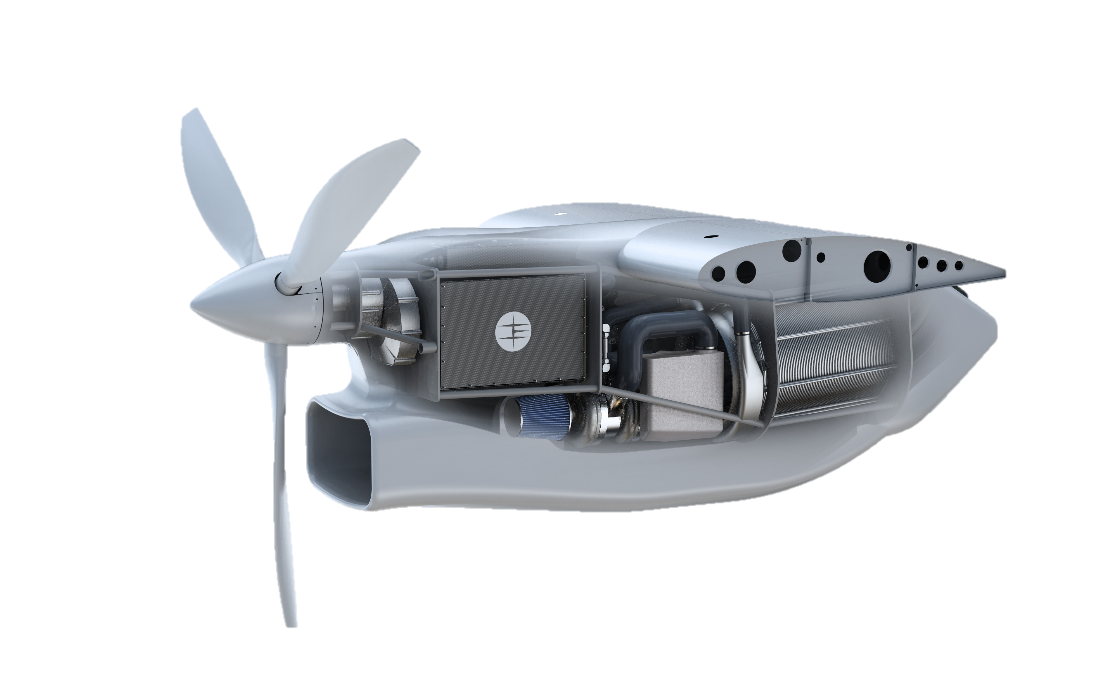
IE-FLIGHT:
100kW – 1MW for aerospace applications
Offer zero-emission energy solutions
High power density
Compact and easy to integrate
Unique patented airflow management
Scalable and modular
Long life span
IE-FLIGHT stack module
IE-FLIGHT F300
Powering the hydrogen future® with our outstanding fuel cells and service.
Notes:
*HT – high temperature

Slide 16
IE-FLIGHT: applications
Committed to achieving zero-emission flight for aviation
External Public – Copyright © Intelligent Energy Limited 2024. All Rights Reserved
Powering the hydrogen future® with our outstanding fuel cells and service.

Slide 17
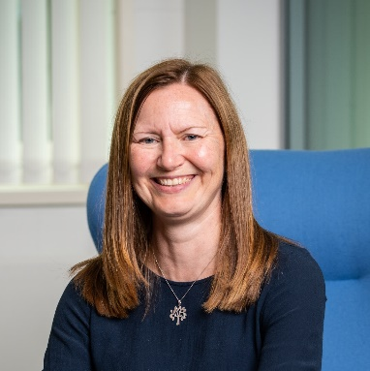
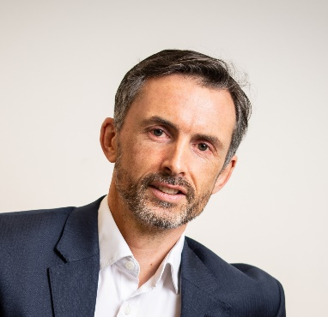
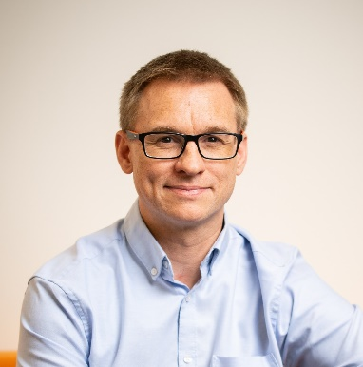
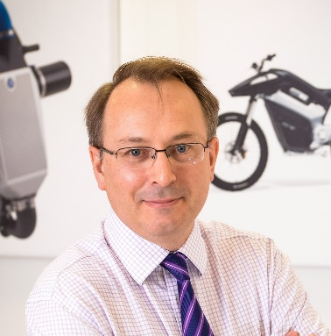
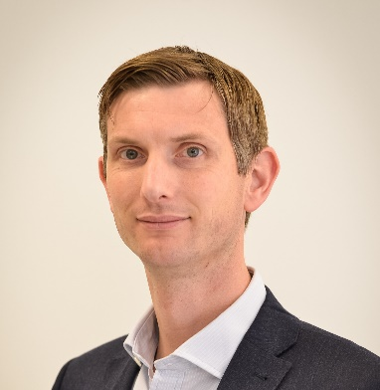
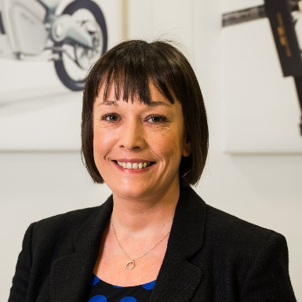
Management team
David Woolhouse
Julia Waite
Simon Read
Greg Harris
Chief Executive Officer
Finance Director
Head of Legal
Chief Commercial Officer
Chris Dudfield
Martin Schaefer
Ashley Kells
Lauren Gurney
Chief Technology Officer
Operations Director
Programme Director
Human Resources Director
External Public – Copyright © Intelligent Energy Limited 2023. All Rights Reserved

Slide 18
Charitable Trust
The Charitable Trust, launched in 2019, donates £100,000 each year to local community groups and organisations in the Charnwood area.
Established to support local causes in need of financial assistance which, support and aid, amongst others; community groups, young people, sport and lifelong learning.
Ownership
The company is part of the Meditor group, a global investment business with interests across a range of industries from energy to pharmaceuticals.

Slide 19
Disclaimer
This presentation was prepared by Intelligent Energy Limited (the “Company”) for information and discussion purposes. No reliance may be placed for any purposes whatsoever on the information contained in this presentation or on its completeness. The Company is not under any obligation to update or keep current the information contained in this presentation. No representation or warranty, express or implied, is given by or on behalf of the Company or its subsidiary undertakings, affiliates, respective agents or advisers or any of such persons’ affiliates, directors, officers or employees or any other person as to the fairness, accuracy or completeness of the information, or of the opinions, contained in this presentation and no liability is accepted for any such information or opinions.
The paragraph above refers to, without limitation, forward-looking statements, including financial and business projections (collectively referred to herein as forward-looking statements). These forward-looking statements are not guarantees of future performance and no reliance should be placed on them. Such forward-looking statements necessarily involve known and unknown risks and uncertainties, which may cause actual performance and financial results in future periods to differ materially from any projections of future performance or results expressed or implied by such forward-looking statements.
Although forward-looking statements contained in this presentation are based upon what management of the Company believes are reasonable assumptions, there can be no assurance that forward-looking statements will prove to be accurate, as actual results and future events could differ materially from those anticipated in such statements. The Company undertakes no obligation to update forward-looking statements if circumstances or management’s estimates or opinions should change. The reader is cautioned not to place any reliance on forward-looking statements.

